Slide 1
Technical Task Management System
End-to-End Technical Ticket Management Platform for EDM

Slide 2
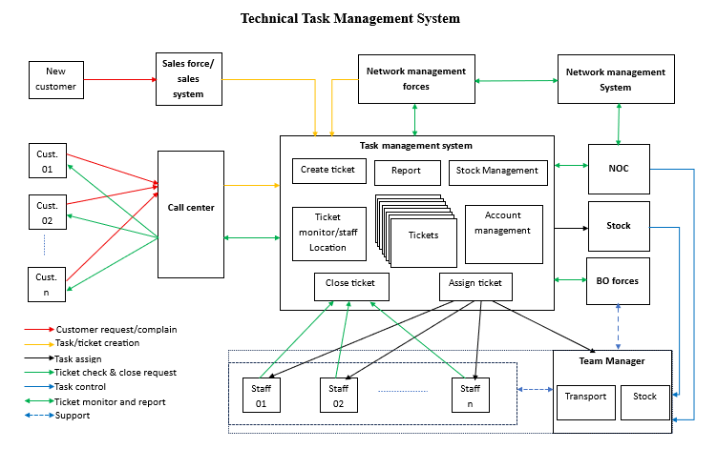

Slide 3
—Peter Drucker
“The best way to predict the future is to create it.”

Slide 4

Business Challenges
Customer complaints,
Manual assignments,
Limited visibility,
Inventory control challenges

Slide 5
Solution Overview
Centralized platform for ticketing;
Workforce management;
Stock control and
Reporting.

Slide 6
Core Functional Modules
Ticket Creation
Ticket Assignment
Ticket Monitoring
Customer problem’s status update
Ticket closing
Stock Management

Slide 7
Core Functional Modules
Account Management
Staff’s location monitor
Reporting

Slide 8
Ticket Lifecycle
Ticket Created
Field Execution
01
02
03
04
Automatic Assignment
Request Received

Slide 9
Ticket Lifecycle
Close Request
Ticket Closed (or reopened)
05
06
07
08
Validation
Status Updates to managers and customer

Slide 10
Validation Authority
Call Center
NOC / Network Management
Customer-related cases
Network-related cases

Slide 11

Customer Complaint Workflow

Slide 12
Customer Fault Resolution Process
Customer contacts Call Center
Call Center creates ticket
System assigns ticket automatically
Technical staff receives task via mobile app/SMS
Team Manager and NOC monitor progress
Technician resolves issue
Closure request submitted
Call Center confirms with customer
Ticket closed or reopened

Slide 13

Benefits
Faster response time
Transparent tracking
Improved customer satisfaction

Slide 14

Network Incident
Workflow

Slide 15
Workflow Process
Ticket automatically generated
Assignment to responsible technician
Incident detected by NMS
Field troubleshooting
Source
Network Management System (NMS)
Key Benefit
Reduced Mean Time To Repair (MTTR)
Ticket closure
NOC verification

Slide 16
New Customer Deployment Workflow
Request → Survey → Installation → activation → customer acceptance process.

Slide 17
Phase 1: Technical Survey
Sales submits survey request
Site assessment performed
Technical feasibility report completed
Phase 2: Service Deployment
Contract completed
Deployment ticket generated
Installation executed, handover
Customer confirmation obtained
Service activated

Slide 18

Workforce Management:
Field Staff Monitoring

Slide 19
Task Assignment
Area-based allocation
Team-based allocation
Performance Monitoring
Ticket completion rate
Response time
Resolution time
Features
Real-Time Location Tracking
GPS-based monitoring
Benefits
Increased productivity
Better resource utilization
Faster service delivery

Slide 20

Stock Management

Slide 21
Functions
Benefits
Material allocation per ticket
Automatic stock deduction Inventory visibility
Consumption tracking
Improved inventory control
Reduced material losses
Better planning and forecasting

Slide 22
Customer Communication

Slide 23
Automated Notifications
Communication Channels
Improved inventory control
SMS
Mobile notifications
Call Center updates
Customers receive updates on:
Ticket creation
Assignment status
Work in progress
Resolution completed
Ticket closure

Slide 24

Reporting & KPI Dashboard

Slide 25
Executive Dashboard
Open tickets
Closed tickets
SLA compliance
Technician productivity
Operational Reports
Ticket status reports
Incident reports
Deployment reports
Inventory usage reports
Management KPIs
MTTR
First Time Fix Rate
Ticket Resolution Rate
Workforce Utilization

Slide 26
Implementation Roadmap

Slide 27
1–2 Weeks
NOTE
Requirements: tasks, forces monitor requirements specification
Surveys: current systems, API for integration, tasks management, workflows, procedures, regulations, KPI, policies, reporting dashboard
Design: structure, workflows, monitors, reports, Mobile application, integration API,
SW development
Implementation and training.
Requirements Analysis
3 Weeks
Workflow Survey
3 Weeks
Related Systems Survey
4 Weeks
System Design & Architecture
Development & Deployment
To Be Agreed

Slide 28
—W. Edwards Deming
“A bad system will defeat a good person every time.”

